Slide 1
Distributed Control and Automation Framework (DCAF)
Introduction to DCAF
Benjamin Celis, Mathew Pollock

Slide 2
Agenda
Introduction
Protocol Getaway
Runtime:
Tag Bus
Engine
Error Handling
Classification
Syslog
Configuration
CEF
Project Development
Scripting and templates
Continues integration
Open Source Projects

Slide 3
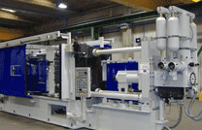
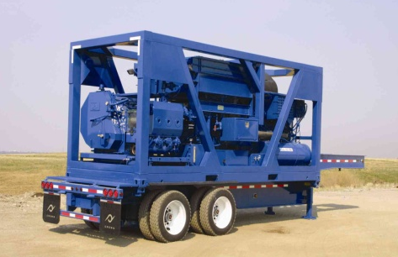


Programming Embedded Control Applications is Hard
RT, FPGA, and user interface programming
Distributed I/O and execution
High cost of failure
Execution guarantees
Understand failure root cause
High availability
System commissioning
Software updates and deployments
Multi-developer teams
Error Handling
Plus the crazy things it actually has to do!
Manufacturing Machines
Heavy Machinery and Equipment
Power Conversion Equipment
Medical Devices
Notes:
RT, FPGA, and UI programming can vary widely in style and knowledge requirements. Being proficient in all three takes both training and experience.
Distributed I/O and execution means a variety of communication protocols to learn. CAN, EtherCAT, UDP, TCP, AMQP, and possibly even the upcoming IIoT protocols may all be involved.
Execution guarantees require knowledge of deterministic programming techniques. Understanding why something failed requires built-in diagnostics and good error handling.
High availability means programs need to be able to run for months or longer without stopping. They also need to be able to recover from a failure automatically.
No two machines are exactly the same. Tuning, features, parameters often need to be tweaked during setup. This requires extensive and powerful parameterization, which ideally is built into the code before it is needed.
These machines are typically built to last. Development teams need a strategy for how to get updates to the code. How do bug fixes or new features get deployed reliably?
These systems are often complex enough and with a tight enough timeline to require multiple software developers. Multi-developer teams don’t work efficiently overnight, and require training and process investments to really flourish.
To top it all off, the functionality for these machines in terms of their primary tasks are complex and getting even more so. It also needs to do those tasks better than the competition.

Slide 4

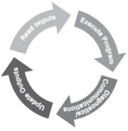


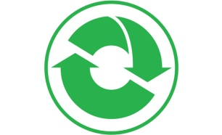



Distributed Control and Automation Framework (DCAF) Overview
An open-source LabVIEW framework for creating configurable, latest value, data engines that can acquire data from multiple input sources, process that data, and then route it back to outputs or to data services.
Create higher quality control applications, in less time.
Scalable and extensible plugin
architecture
Develop with plugin templates
Reuse existing plugins
Define and configure plugin
parameters
Single point I/O, processing, and
data services
Rules for correct-by-construction
software
Configure timing and error handling
Optimized for real-time execution
Notes:
The Tag Bus Data Framework or TBDF is an open-source LabVIEW framework for creating configurable, latest value, data engines that can acquire data from multiple input sources, process that data, and then route it back to outputs or to data services. It provides a scalable and extensible plugin architecture. It supports users in the development of new plugins with a variety of templates… …and the framework was designed to allow plugins to be reused easily across projects. Reuse is easy because each plugin can define configuration parameters which can be specified using a configuration editor. This also allows plugin behavior to change across multiple deployments of the same application. While applicable to a wide variety of use-cases, the framework was primarily built for applications using a lot of single point I/O: things like control data or industrial communication protocols. The plugin architecture helps facilitate multideveloper teams, and the framework handles the intricacies of execution timing and error handling for its users. Finally, while the framework can run on RT, Windows, and Interact with FPGAs, it was built primarily for applications executing on a real-time OS.

Slide 5
Who should use the framework?
New developers in LabVIEW:
Allows them to work on what the application has to do, rather than how they have to do it.
Abstracts Real Time concepts for the user
Provides a configurable I/O Abstraction layer
Forces good programing practices
Advanced developers:
Efficient data mapping engine
Extensible configuration interface
Excellent code reuse between projects
Know LabVIEW but doesn’t want to write too much architecture
Open source and distributed in components that are useful individually

Slide 6
How?
Configuration
Runtime
Configuration Editor
Engine
Modules

Slide 7
DCAF Modules
In Work
FPGA
Alarms
OPC UA Client
TSN
New
DDS
J1939
Shared Memory
PID
Existing
Modbus
Scan Engine
UDP
LED
Profibus
Ethernet/IP
Scaling
Tag Select
UI
CVT
TDMS
…

Slide 8
Anatomy of a Module
Editor Node
User interface
Runs on PC
Creates or modifies the configuration
Contains the configuration class
Configuration
Created on PC, passed to runtime system
Provides data access and serialization/unserialization methods
Data storage only, no editor or runtime logic
Runtime Node
Initializes runtime based on configuration
Provides execution logic
Configuration
Editor node
Runtime node

Slide 9
Engine
Engine
Input
Process
Output
Outside
Outside
Outside

Slide 10
Demo

Slide 11
Who is DCAF for?
Application Type: Control and Automation
Single-point I/O, processing, and services
Outputs provided in real-time
Not Real-Time Test
Not Monitoring or Data Acquisition
Scope Type: Deployed Solution
Built product (internal or external)
Project time measured in months
Not a Simple Demo/POC
Tool Type: LabVIEW
Some LabVIEW experience needed
Shared memory integration with C/C++ apps
Not Ladder/61131 developers
Control
Solution
LabVIEW
Notes:
DCAF was designed specifically to help people build better control solutions in LabVIEW. There are plenty of other ways to take advantage of the framework and its components in other applications areas, but control is the main target today. The last thing we want is for anyone to use the framework for the wrong job.

Slide 12
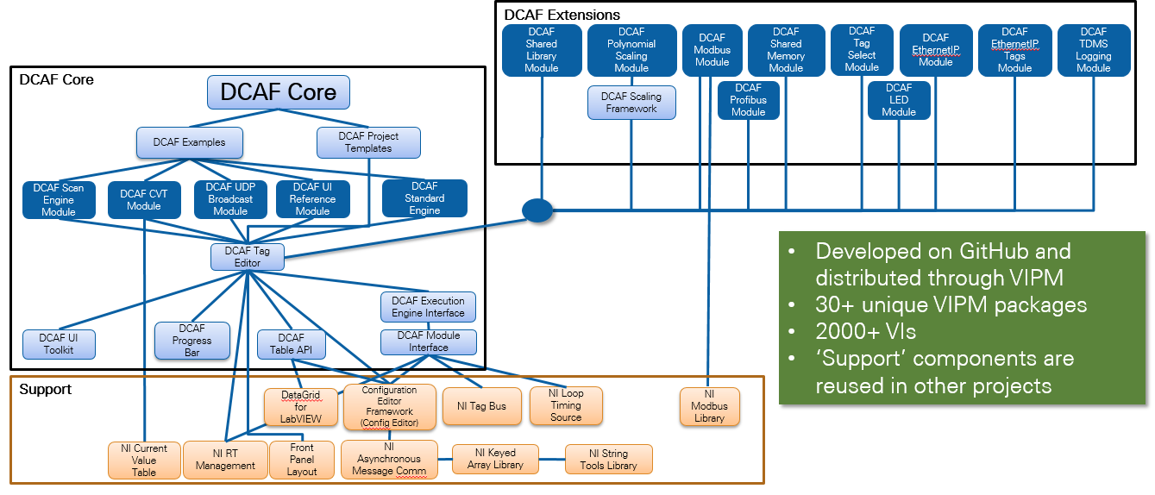
DCAF Package Dependency Diagram
Notes:
Useful for navigating Tools Network packages and GitHub Repos
May be the largest open source LabVIEW development project

Slide 13

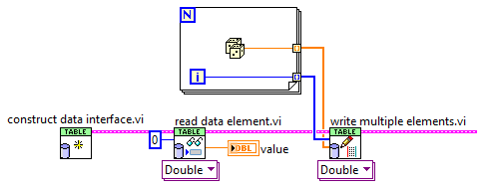
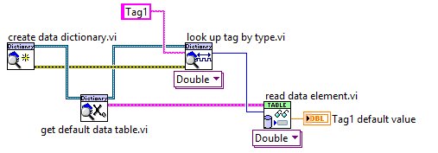
Tag Bus
CVT on the wire
Not a Global
Data Protection
Fast
Reduced memory
Filtering
Tag Manipulation
Tags are Objects

Slide 14
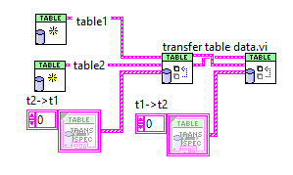
Transfer Between TagBus

Slide 15

Engine Execution Model
DCAF Execution Engine
Run State
Shutdown
Idle
Tag Bus
Inputs
Process
Outputs
Upkeep
Wait
Configuring
Plugin1
Plugin3
Plugin1
Fault Recovery
Plugin2
Plugin4
Plugin5
House-Keeping
Safe State
Notes:
State machine with a safe state
Sequentially executes Input, Process, and Output methods of each plugin
Passes latest value data between plugins
Configurable execution timing
Built-in error reporting and recovery
Prevent Race conditions, memory allocations, thread starvation, etc.

Slide 16
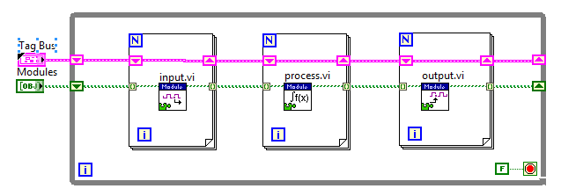
Simplified Engine

Slide 17
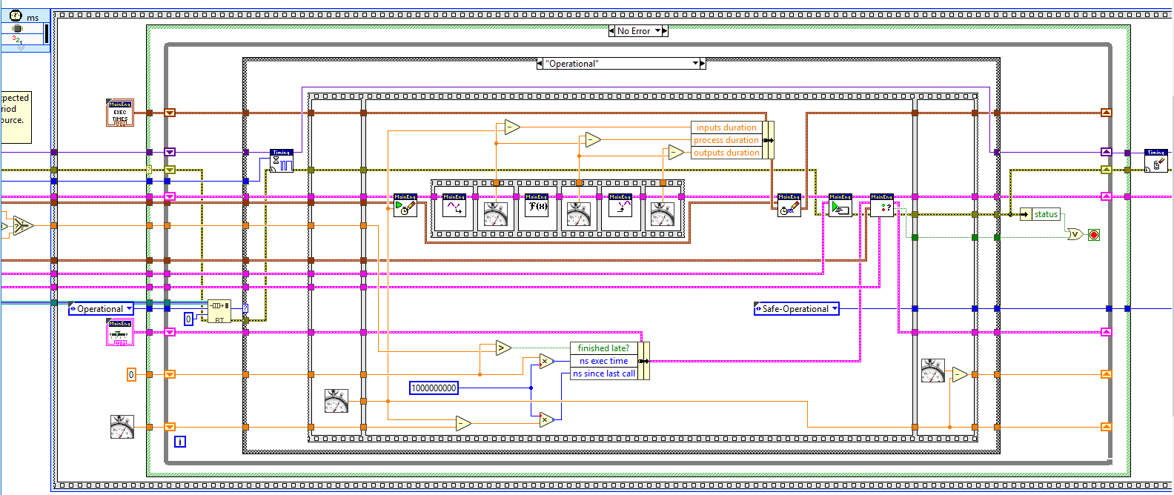
DCAF Execution Engine
Notes:
The source code for the engine isn’t as scary as you might think. It follows a pretty straightforward sequence of steps:
Check for a message to stop.
Wait for next clock source to fire.
Sequentially read all inputs and store data on the bus.
Process data and store on bus, then process again and store on the bus, then process again. Etc.
Send data to all output locations sequentially.
Choose which plugins execute on the next iteration.
Check for errors and handle them.
Sequential execution provides predictable behavior.
C:\Program Files (x86)\National Instruments\LabVIEW 2017\vi.lib\NI\DCAF\Engines\Standard Engine\Execution Engine\main engine\primary control loop.vi

Slide 18
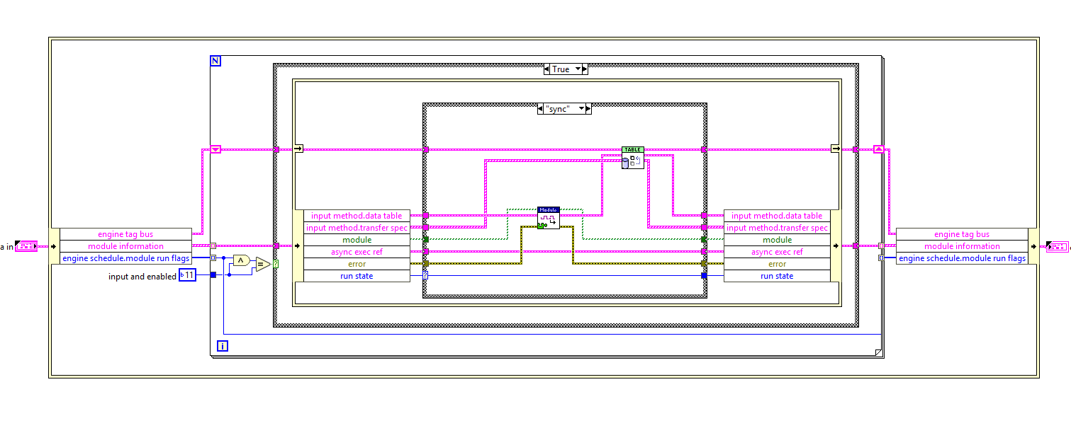
Input

Slide 19
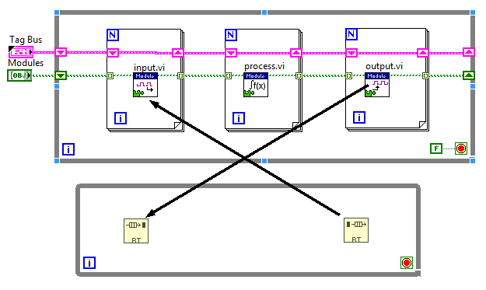
Execute Asynchronously?

Slide 20
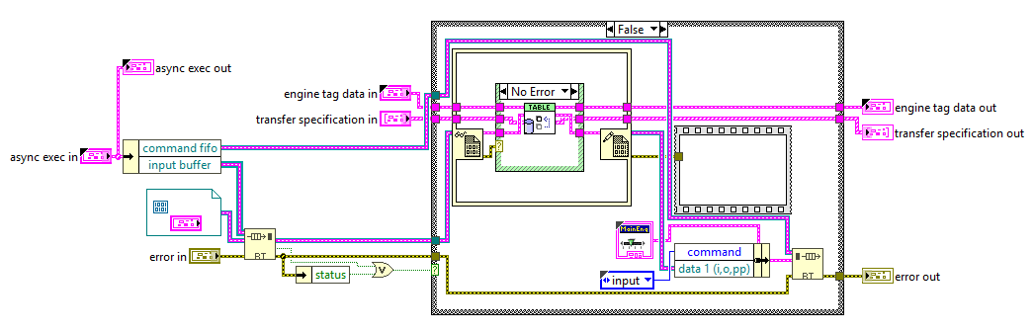
Execute Asynchronously?

Slide 21
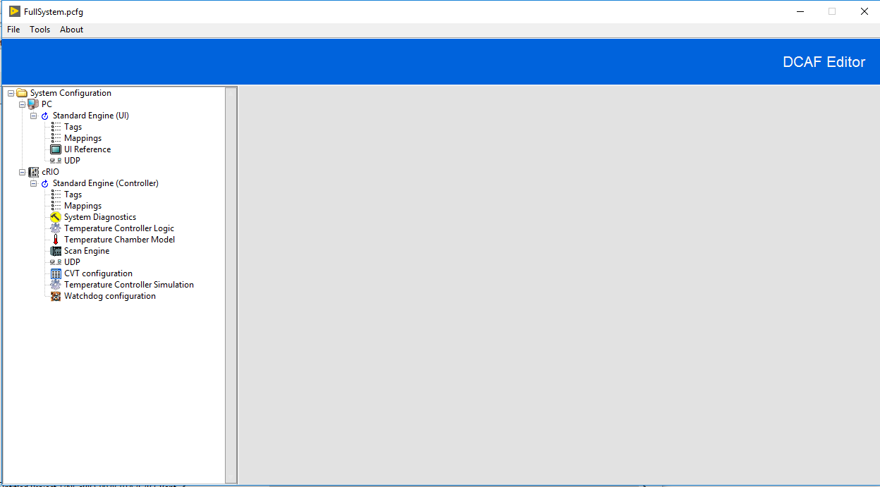
Configuration Editor Framework (CEF)
Open Source Library
Tools to manage tree control and subpanels
Can be extended and customized
3 starting templates available

Slide 22
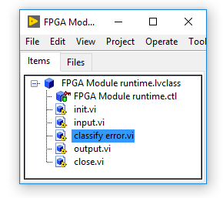
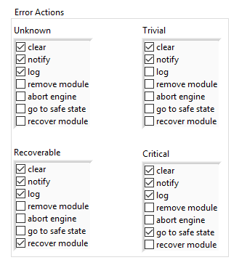
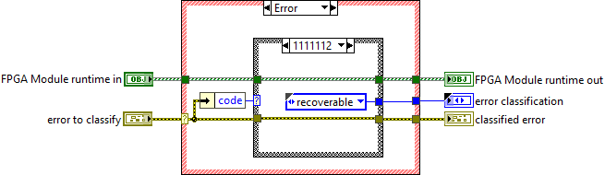
Error Management

Slide 23

Syslog
Available in Linux RT Targets
Event sent to Log:
Initialization and shutdown of all software modules
Any error reported to the engine
Any module trace messages added via the API

Slide 24
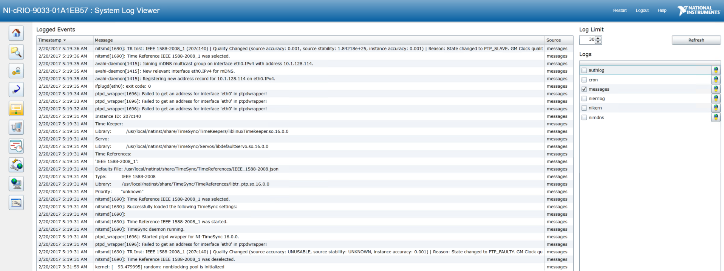
System Log View

Slide 25
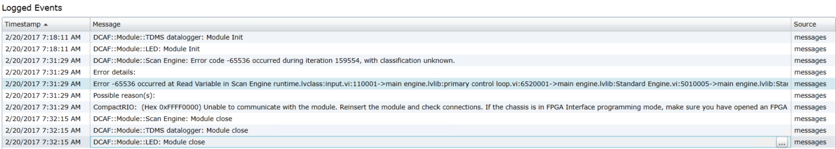
System Log View

Slide 26
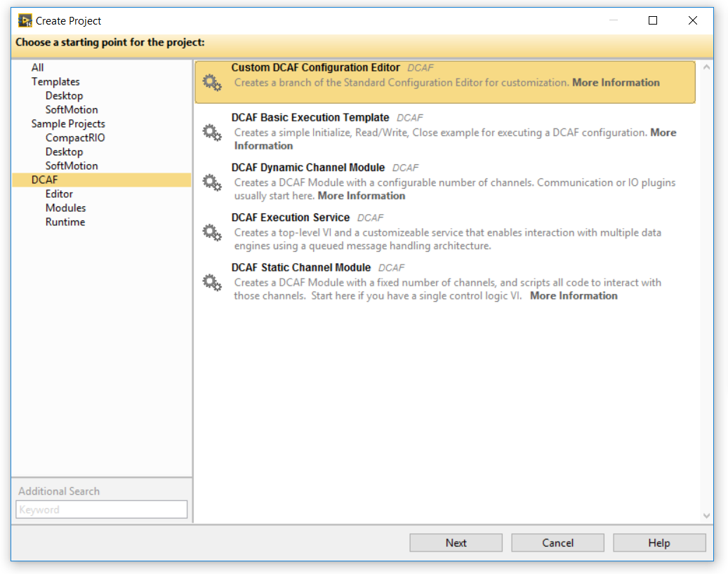
DCAF Project Templates
Notes:
Application templates exist in addition to the plugin templates.

Slide 27
Which Template to Choose
Dynamic
Unknown number of Channels.
Final user defines the inputs
Modbus
Needs more codding
Static Template
Number of channels decided by module developer
Mostly Scripted
PID

Slide 28
Related Sessions
Shared Memory Module
A Match Made in Memory: C/C++ and LabVIEW RT on NI Linux RT
Monday at 3:30 17B
Managing Open Source Projects in LabVIEW
DCAF issue tracking, pull requests, developer merge workflow, licensing
Today at 2:30 13 A/B
Thursday at 9:15 16B
Creating Reliable Releases: Continuous Delivery in LabVIEW
DCAF build system with Jenkins Pipelines
Today at 9:30. Hope you were there!
Thursday at 10:30 19B

Slide 29
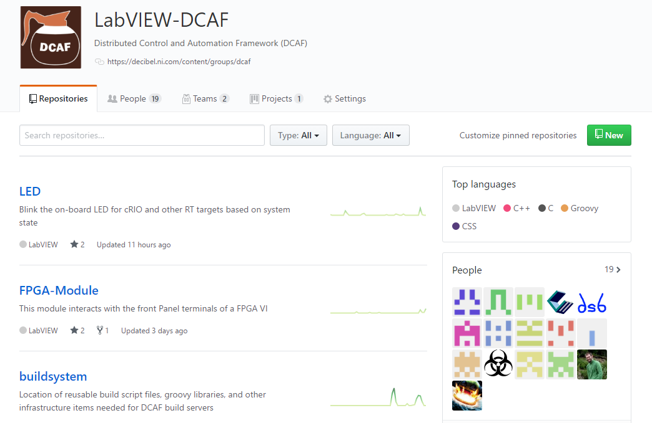
Resources
ni.com/DCAF
Getting started material
Support forum
github.com/LabVIEW-DCAF
Issue reporting
Pull requests welcome!

Slide 30
Notes:
We want your feedback. Please take one minute to complete the session survey.

Slide 31
Thank you for attending Alliance Day 2017.
Notes:
As a speaker of NIWeek, begin your session by welcoming attendees.
Convey these points:
Your time is valuable, thank you for being at NIWeek 2017.
We aim to make this as valuable as possible, from sharing best practices to helping connect you to fellow engineers and NI experts.

Slide 32
10 a.m. – 12:45 p.m. Morning Sessions 4th Floor
Rooms 11-19
12:45 p.m. Lunch Keynote/Awards Ceremony Expo Hall 4
2:30 – 5:30 p.m. Afternoon Sessions 4th Floor
Rooms 11-19
5:30 – 7 p.m. NIWeek Welcome Happy Hour/ Expo Hall 3
Exhibition Opens
Alliance Day 2017
Schedule At A Glance

Slide 33
Notes:
Convey these points:
Thank you for attending NIWeek 2017.
There’s many ways to stay connected.
You can download the session materials through the mobile app or at ni.com/niweekcommunity.
If you’re interested, you can reach me at [share your email]

Slide 34
Users and Project Types
Users
New Developers
Intermediate Developers
Advance Developers
Applications
T1
All modules exist
T2
Static Module
T3
Dynamic Module
T4
Engines

Slide 35
How to use DCAF
Use it as a main architecture
Use it to manage the tags of the application next to your application
Use it as an example

